Slide 1
Electrophysiology Part 1: Ion Channels
And separation of charge across neuronal membranes
Kimberle M. Jacobs, Ph.D.
827-2135
Kimberle.Jacobs@vcuhealth.org
Sanger, 12-042
804 387-0140
Please be ready to log into Slido.com on a browser
627 934

Slide 2
What do you think of when you hear the word electrophysiology?
ⓘ Start presenting to display the poll results on this slide.

Slide 3
What does the nervous system use for signaling?
ⓘ Start presenting to display the poll results on this slide.

Slide 4
What does the nervous system use for signaling?
Or
What happens in the brain/nervous system when you perceive the pencil in your hand,
the black lines forming words on this slide,
the sound of the screen lowering
What is different in the brain than before this perception happened?

Slide 5
Consciousness and perception depend on neuronal activity
Can start with a small signal such as a single photon or single odor molecule – neurons must respond very quickly –
What do they change? Membrane potential – and ultimately rate of action potential firing.
Rapid changes in membrane potential are mediated by ion channels (integral membrane proteins)
Ion channels are ‘tuned’ to respond to specific physical and chemical signals
Ion channels have critical roles in both normal and patho-physiology
2nd class of molecules – ion pumps – maintain concentrations of physiologically important ions inside vs outside the cell

Slide 6
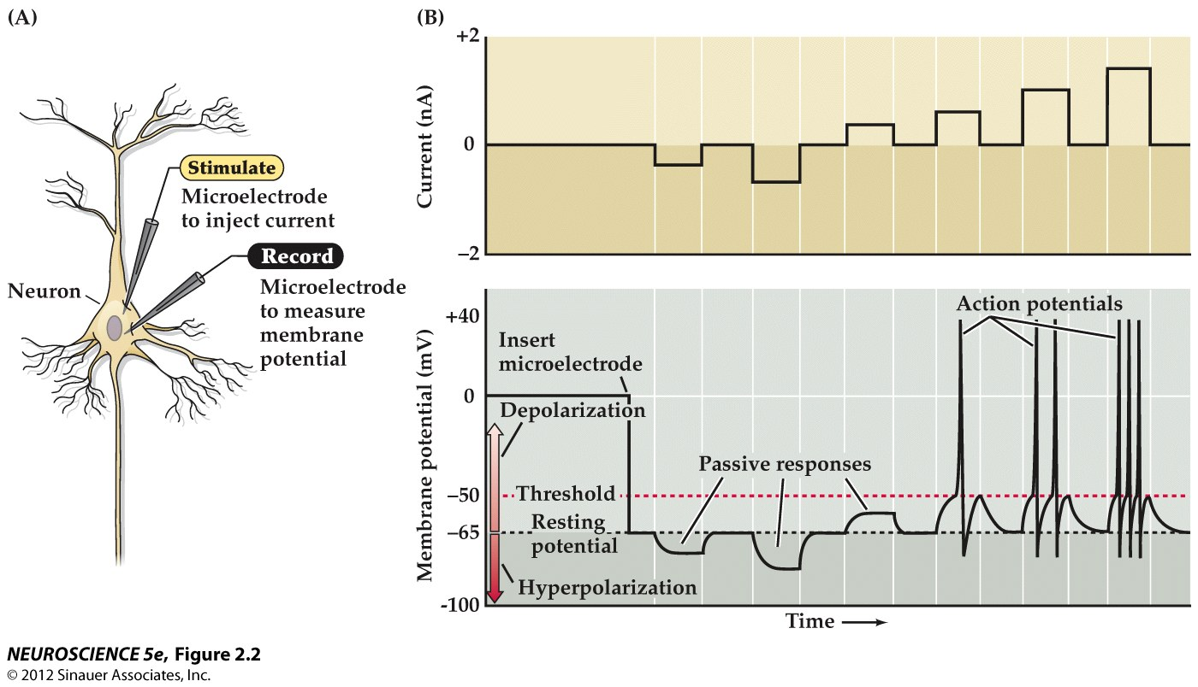
Active vs Passive Neuronal Responses
Step or square pulse of current controlled by experimenter and injected into cell
Notes:
Injecting current into cell – negative current produces hyperpolarizing response – get downward deflection in membrane potential, pass small amount of positive current – get upward (depolarizing response), but if you pass enough current, then you reach the threshold for voltage sensitive Na+ channels and thereby produce the active response of an action potential. So passive – the response is graded relative to the size of the input – the neuron is ‘following’ the input current. Active – the response is all or none and not graded in amplitude with size of input current – but it will be graded in terms of the frequency of action potentials elicited.

Slide 7
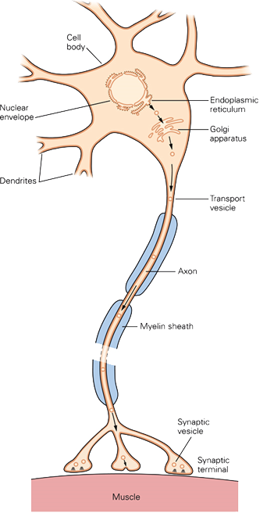
input
Amplifier
output
Oscilloscope
input
0 mV
-60 mV

Slide 8
input
Amplifier
output
Oscilloscope
input
0 mV
-60 mV
Notes:
The electrode here is a glass pipette filled with an ionic solution (a conductor). That solution is connected to a wire (red line) that takes the electrical information into the amplifier. The purpose of the amplifier is to make the signal bigger (relative to the amount of electrical noise present). The purpose of the oscilloscope is to view the signal. The oscilloscope does not change the signal in any way. You can change the DISPLAY of the signal but not change the signal itself on the oscilloscope.

Slide 9
what would the potential read on the oscilloscope at this point?
ⓘ Start presenting to display the poll results on this slide.

Slide 10
input
Amplifier
output
Oscilloscope
input
0 mV
-60 mV
Notes:
The electrode here is a glass pipette filled with an ionic solution (a conductor). That solution is connected to a wire (red line) that takes the electrical information into the amplifier. The purpose of the amplifier is to make the signal bigger (relative to the amount of electrical noise present). The purpose of the oscilloscope is to view the signal. The oscilloscope does not change the signal in any way. You can change the DISPLAY of the signal but not change the signal itself on the oscilloscope.

Slide 11
input
Amplifier
output
Oscilloscope
input
0 mV
-60 mV

Slide 12
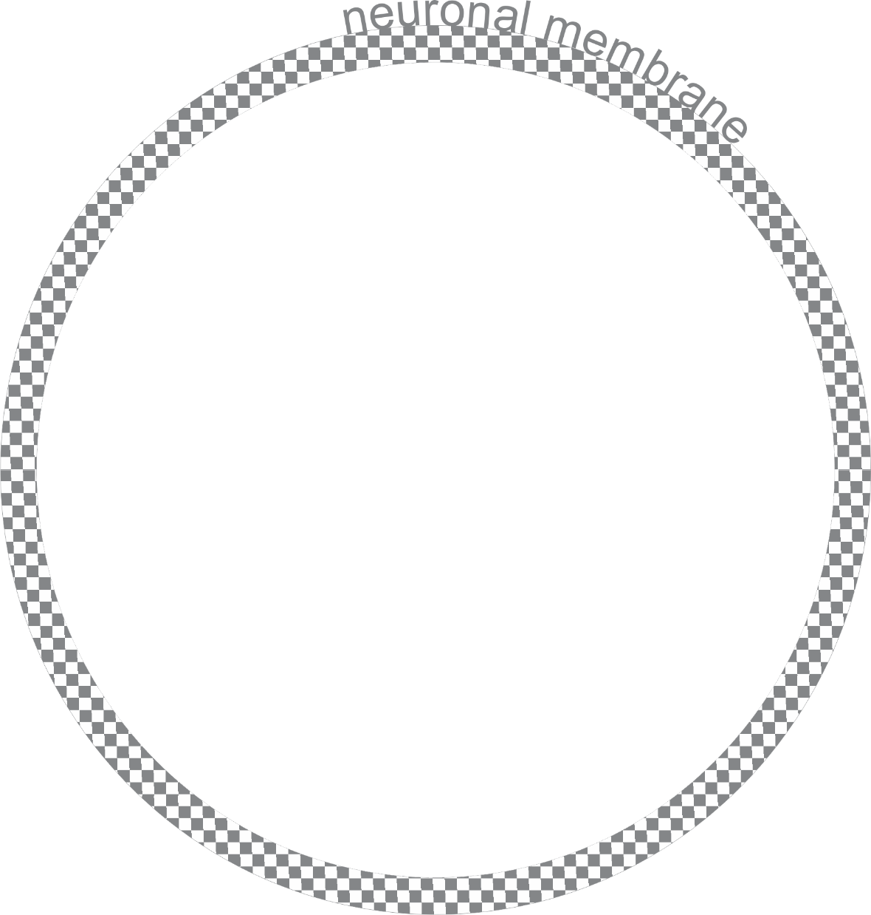
extracellular
Set to
0 mV
A main function of the membrane is separation of charge!
intracellular
= -60 mV
How does the membrane provide that separation and
How do we get communication between inside and outside of cell?

Slide 13
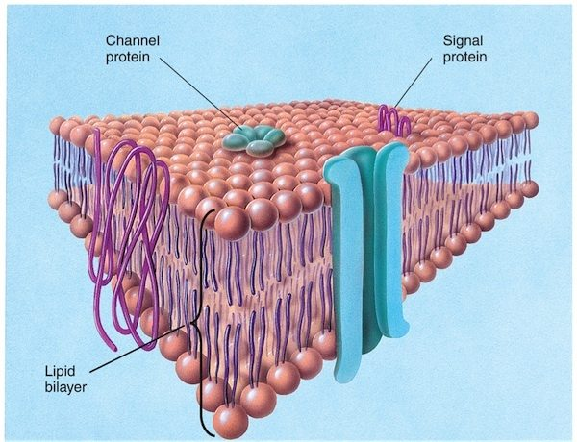
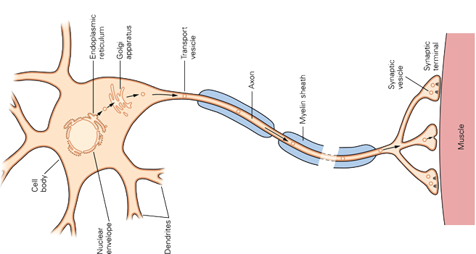
The membrane consists of a phospholipid bilayer
Notes:
The membrane consists of a phospholipid bilayer – the polar head is hydrophilic – meaning that it likes water – versus the lipid part make up of fatty acid is hydrophobic THe hydrophobic ends point towards each other leaving the hydrophilic heads towards the aqueous extracellular fluid and towards the aqueous intracellular fluid. It would take tremendous energy to push an ion through the hydrophobic lipid.
Embedded in this phospholipid bilayer are proteins – channel proteins span the entire phospholipid bilayer creating an aqueous channel through which ions pass.

Slide 14
What are ion channels?
Ion channels are large integral-membrane proteins with a core transmembrane domain that contains a central aqueous pore spanning the entire width of the membrane.
Why do ions want to pass through channels from extracellular to intracellular or vice versa??
Concentration gradient
Even if you start with most of the small red circles on the left, because they can pass through – they redistribute across the membrane until they are equally distributed.
Notes:
Extra info on hydrophilic: https://study.com/academy/lesson/hydrophilic-definition-interaction-quiz.html

Slide 15
Ion Channels are selective for particular ions – Why?
Size! Large ions can’t fit through small channels
chemical electrostatic interactions inside the channel can prevent ions from passing through
Notes:
Ion channels allow the passage of ions from inside to outside of the cell. Membrane is 6-8 nm thick. Lipids do not mix with water. Although the net charge of water is zero, there is separation of charge within the molecule. This dipole nature attracts water to ions. Thus the ions are hydrophilic. Make sure they know the meaning of these terms – hydrophobic, hydrophilic
Ion cannot move away from water into the non-charged hydrocarbon tails of the lipid bilayer in the membrane unless a large amount of energy is expended to overcome the attraction between the ion and surrounding water molecules.
**Channels (not just holes) are distinct protein structures that span the lipid bilayer.
Selectivity is not just based on size – smaller ions have more highly localized charge and stronger electric field – so attract water more strongly. Thus Na+ although crystal radius is smaller – it has a larger water shell and therefore behaves as if it is larger than K+
So Na+ is functionally too big to fit through K+ channel, but why doesn’t Na+ channel let in K+?
Hille proposed that there is a selectivity filter within the pore – an ion must shed most of its waters of hydration to traverse the channel – then weak chemical bonds (electrostatic interactions) for with polar (charged) amino acid residues that line the walls of the channel. Quick binding to selectivity filter (< 1 usec) – then electrostatic and diffusional forces propel the ion through the channel. Smaller radius of sodium it will approach neg site in channel pore more closely than K+ and thus have a more favorable free-energy change on binding. This compensates for the water it must lose to do the binding. Carboxylic groups will bind Na+ more tightly than K+ 0 but polar carbonyl or hydroxyl oxygen atoms would select K+ (less bound to water) over Na_ - SO it is a combination of chemical interactions and molecular sieving based on pore diameter

Slide 16
Ion Channels are selective for particular ions – Why?
The water surrounding the Na+ makes it effectively larger than K+.
This is why Na+ won’t pass through the smaller K+ channel.
K+ channels are 100X more permeable to K+ than to Na+
Why doesn’t K+ pass through Na+ channel?
selectivity filter theories:
The way the filter works – carboxylic groups allow ion to shed its water jacket
Binding in order to shed water jacket is more likely for smaller Na+.
Notes:
Ion channels allow the passage of ions from inside to outside of the cell. Membrane is 6-8 nm thick. Lipids do not mix with water. Although the net charge of water is zero, there is separation of charge within the molecule. This dipole nature attracts water to ions. Thus the ions are hydrophilic. Make sure they know the meaning of these terms – hydrophobic, hydrophilic
Ion cannot move away from water into the non-charged hydrocarbon tails of the lipid bilayer in the membrane unless a large amount of energy is expended to overcome the attraction between the ion and surrounding water molecules.
**Channels (not just holes) are distinct protein structures that span the lipid bilayer.
Selectivity is not just based on size – smaller ions have more highly localized charge and stronger electric field – so attract water more strongly. Thus Na+ although crystal radius is smaller – it has a larger water shell and therefore behaves as if it is larger than K+
So Na+ is functionally too big to fit through K+ channel, but why doesn’t Na+ channel let in K+?
Hille proposed that there is a selectivity filter within the pore – an ion must shed most of its waters of hydration to traverse the channel – then weak chemical bonds (electrostatic interactions) for with polar (charged) amino acid residues that line the walls of the channel. Quick binding to selectivity filter (< 1 usec) – then electrostatic and diffusional forces propel the ion through the channel. Smaller radius of sodium it will approach neg site in channel pore more closely than K+ and thus have a more favorable free-energy change on binding. This compensates for the water it must lose to do the binding. Carboxylic groups will bind Na+ more tightly than K+ 0 but polar carbonyl or hydroxyl oxygen atoms would select K+ (less bound to water) over Na_ - SO it is a combination of chemical interactions and molecular sieving based on pore diameter

Slide 17
Ion Channels are selective for particular ions – Why?
e
Molecules that make up the channel create a selectivity filter with binding sites inside the channel that allow for electrostatic interactions.
So the selectivity of the channel is based on a combination of chemical interactions AND molecular sieving due to pore diameter.
e
e
Notes:
Ion channels allow the passage of ions from inside to outside of the cell. Membrane is 6-8 nm thick. Lipids do not mix with water. Although the net charge of water is zero, there is separation of charge within the molecule. This dipole nature attracts water to ions. Thus the ions are hydrophilic. Make sure they know the meaning of these terms – hydrophobic, hydrophilic
Ion cannot move away from water into the non-charged hydrocarbon tails of the lipid bilayer in the membrane unless a large amount of energy is expended to overcome the attraction between the ion and surrounding water molecules.
**Channels (not just holes) are distinct protein structures that span the lipid bilayer.
Selectivity is not just based on size – smaller ions have more highly localized charge and stronger electric field – so attract water more strongly. Thus Na+ although crystal radius is smaller – it has a larger water shell and therefore behaves as if it is larger than K+
So Na+ is functionally too big to fit through K+ channel, but why doesn’t Na+ channel let in K+?
Hille proposed that there is a selectivity filter within the pore – an ion must shed most of its waters of hydration to traverse the channel – then weak chemical bonds (electrostatic interactions) for with polar (charged) amino acid residues that line the walls of the channel. Quick binding to selectivity filter (< 1 usec) – then electrostatic and diffusional forces propel the ion through the channel. Smaller radius of sodium it will approach neg site in channel pore more closely than K+ and thus have a more favorable free-energy change on binding. This compensates for the water it must lose to do the binding. Carboxylic groups will bind Na+ more tightly than K+ 0 but polar carbonyl or hydroxyl oxygen atoms would select K+ (less bound to water) over Na_ - SO it is a combination of chemical interactions and molecular sieving based on pore diameter

Slide 18
How do you initiate the opening of an ion channel?
ⓘ Start presenting to display the poll results on this slide.

Slide 19
Types of Ion Channels
Resting or leak channels
Voltage-gated
Ligand-gated
Mechanically-gated
Only open with this type of stimulus to the channel.
Once open:
Ion channels pass ions based on chemical and electrical gradient.
Chemical gradient – if there is more of ion X on the outside than the inside, then there is a force pushing ion X to inside (which is only effective when the channel for ion X is open)
Electrical gradient – if the ion X has a positive charge (X⁺) then in the typical situation of a ~-60 mV intracellular potential, that ion will be driven towards the inside of the cell (attracted to the negative on the inside and repelled from the positive on the outside)
When the electrochemical force is balanced on inside vs outside for a particular ion, then it is in equilibrium. In neurons, for each ion there is an equilibrium potential – that is the membrane potential at which there is no longer any driving force on the ion to move, so that the NET flow of that ion is 0.

Slide 20
When the membrane potential is at the equilibrium potential for K+, does that mean there is the same amount of K" inside the cell as outside the cells?
ⓘ Start presenting to display the poll results on this slide.

Slide 21
If the neuron's membrane potential is at -60 mV and ion X's equilibrium potential is -70 mV, when the X ion channels open, how much force is pushing the neuron toward's X's equilibrium potential
ⓘ Start presenting to display the poll results on this slide.

Slide 22
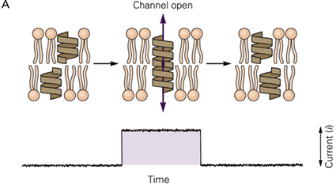
To understand the properties of channels an artificial channel was created.
Early 1960’s - paint a drop of phospholipid over a hole in a non-conducting barrier that separates two salt solutions. THEN add an antibiotic (gramicidin A – effectively creates channels in membrane). Then small step-like changes in current across the membrane can be measured – all or none opening and closing of the single ion channel.
Dimerization of gramicidin peptides
Channel behaves as a simple resistor and amplitude of the single-channel current can be obtained from
Current through the channel varies with membrane potential.
For ion channels - more commonly the inverse of resistance is used: conductance.
Notes:
Think of channel opening like this: when channel opens then the electrical and chemical drives are then pushing the cell to get to that ion’s equilibrium potential. Let’s think of Na+ channels. The typical Na+ equilibrium potential is +65 mV. That means only when the cell gets to +65 mV will there no longer be any net flow of Na+ ions. Normal neuronal membrane potential is around -60 mV. So when the Na+ channels open – the Na+ drive is trying to get to +65 mV – that is a long way away – so there is a strong or large driving force. And because the conductance of the channel is fixed (unchanging due to molecular structure), the flow rate or current will also be large.

Slide 23
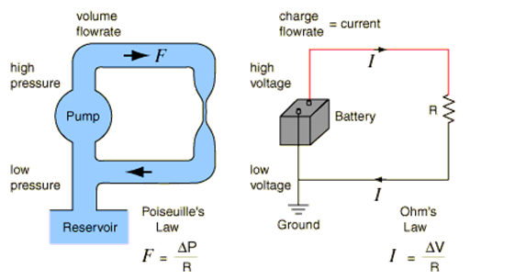
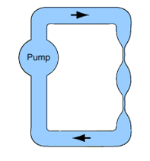
Water analogy for understanding electrical circuits
Pump or Pressure = Battery (potential difference)
Flow = Current (rate of charge flow)
Restriction = Resistance (opposes current flow)
R₁
V_{tot}
R₂
Notes:
Bottom is just an example comparing an electrical schematic to the same diagram for water.
Poiseuille = Pwaa-zuh-ee

Slide 24
To understand the properties of channels an artificial channel was created.
Early 1960’s - paint a drop of phospholipid over a hole in a non-conducting barrier that separates two salt solutions. THEN add an antibiotic (gramicidin A – effectively creates channels in membrane). Then small step-like changes in current across the membrane can be measured – all or none opening and closing of the single ion channel.
Dimerization of gramicidin peptides
Channel behaves as a simple resistor and amplitude of the single-channel current can be obtained from
Ohm’s Law: V = i*R
or i = V/R,
where i is the current through the single channel (measured in amperes or amps); V is the voltage across the membrane (measured in volts); and R is the resistance of the open channel (measured in ohms) – typically for a single open channel it is 8 X 10¹⁰ Ohms.
Current through the channel varies with membrane potential.
For ion channels - more commonly the inverse of resistance is used: conductance. γ = 1/R
So if expressing Ohm’s law in terms of conductance, it is I = γ∗V

Slide 25
Ohm’s Law V = I*R or I = γ∗V
Remember that I (current) is the flow rate through the circuit.
V is how much separation of charge there is (battery) and therefore the pump pushing the flow.
R is how much resistance the current flow is getting – so when we think of this in relation to a single channel, it is how easily the ions can pass through the channel = that channel’s conductance.
units:
Voltage is measured in volts, typically millivolts for neurons Current (I) is measured in amps typically picoamps or pA for neurons Resistance is measured in ohms (Ω), typically megaOhms for neurons
Conductance is measured in siemens, typically picoSiemens for neurons,
1 Siemen = 1/1 Ohm

Slide 26
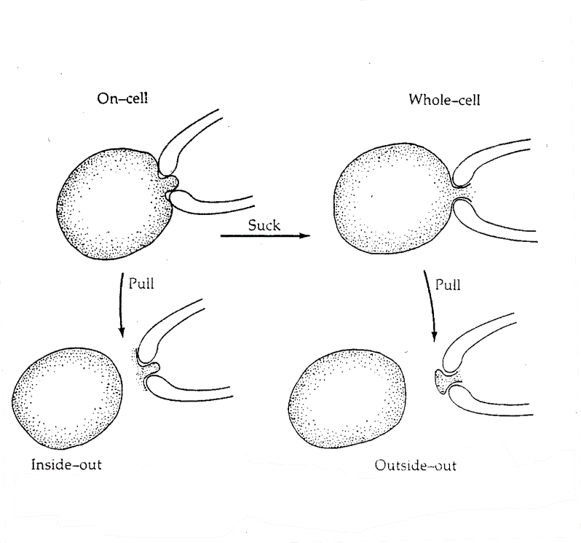
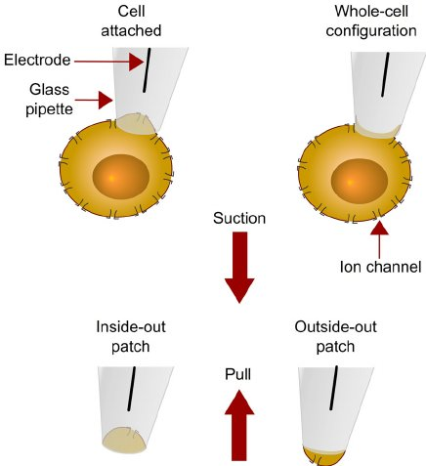
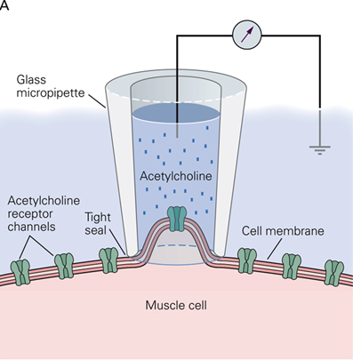
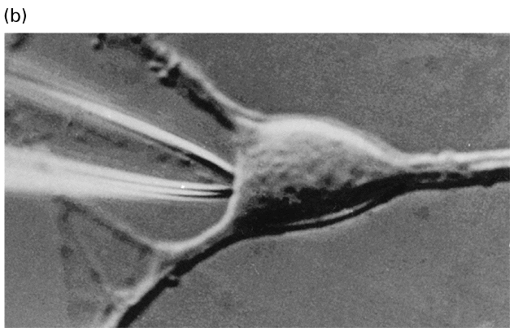
How do we measure these electrical aspects in neurons and muscles?
The patch clamp technique
Pull electrode quickly away from cell
Slowly pull electrode away from cell
Bring glass pipette with a tip diameter of ~ 1μm up to cell wall and apply suction to create a high resistance (gigaohm) seal.
Logethetis

Slide 27
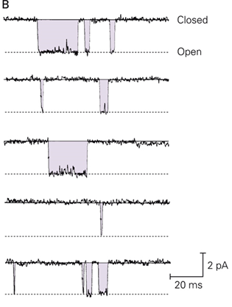
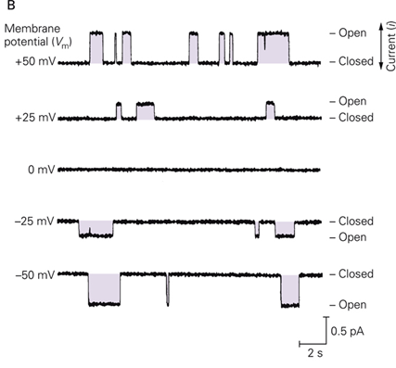
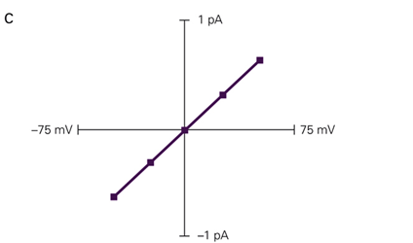
Channel behavior during patch clamp recordings
Channel openings are all or none - same amplitude every time, (at a particular membrane potential). The duration of opening varies.
In this recording from ACh channels in a muscle, there is a linear relationship between current and voltage. Conductance for this channel is fixed – doesn’t change with membrane potential. So by Ohm’s law, as you change the membrane potential, the amplitude of the current that you are measuring will also change. I = γ*V
Y = m*X +b
Where m is slope and b is offset.
b = 0 (line crosses through 0,0)
i = γ*V
Changing V, measuring i so γ is the slope.
Experimenter is changing the membrane potential
Experimenter is measuring the current.
The potential at which it reverses is called the Reversal or equilibrium potential for that channel/ion
Notes:
Linear or ohmic relationship for this channel.

Slide 28
Some cation channels pass more than one type of ions, but others are more selective. Most anion channels are very selective for a single ion – like Cl⁻.
Remember that there is both a chemical (diffusional) gradient and an electrical gradient on any given ion – together they are the electrochemical gradient.
When the channel opens then this gradient is applied in what is called “driving force” - the ion is being driven to equilibrium at which there would no longer be any driving force. At some potential difference between inside and outside of the cell - that equilibrium is achieved.
When the channel acts as a simple resistor, the driving force varies linearly with changes in membrane potential.
Rectification
But for some channels there is a nonlinear relationship between driving force and membrane potential. This means that at some particular membrane potential there is a different conductance (change in slope) than at other membrane potentials.

Slide 29
Example of a rectifying channel
NMDA receptor current
Reversal or equilibrium potential
Ligand-gated channel
Plot examples from: Kirson & Yaari, J Neurosci, 20:4844.
Na⁺
Na⁺
Ca²⁺
Mg²⁺
Mg²⁺
Glutamate
NMDA
NMDA
+
+
+
+
-70 mV
+
+
+
Postsynaptic
Dendrite
Postsynaptic
Dendrite

Slide 30
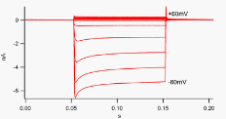
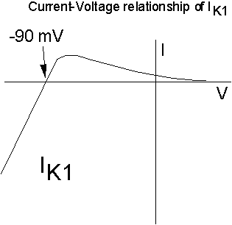
There is little to no current when the cell is at very positive membrane potentials. At potentials positive to -90 mV, the K+ ion will flow out of the cell. At potentials negative to -90 mV (the reversal or equilibrium potential), K+ will flow into the cell. The current is much larger when potassium is flowing into the cell, thus this is an inwardly rectifying channel.
Notes:
At negative membrane potentials the K+ wants to flow out of the cell.
Whole-cell current recordings of K_{ir}2 inwardly-rectifying potassium channels expressed in an HEK293 cell. (This is a strongly inwardly rectifying current. Downward deflections are inward currents, upward deflections outward currents, and the x-axis is time in seconds.) There are 13 responses superimposed in this image. The bottom-most trace is current elicited by a voltage step to negative 60mV, and the top-most to positive 60mV, relative to the resting potential, which is close to the K⁺ reversal potential in this experimental system. Other traces are in 10mV increments between the two.
The phenomenon of inward rectification of K_{ir} channels is the result of high-affinity block by endogenous polyamines, namely spermine, as well as magnesium ions, that plug the channel pore at positive potentials, resulting in a decrease in outward currents. This voltage-dependent block by polyamines results in efficient conduction of current only in the inward direction. While the principal idea of polyamine block is understood, the specific mechanisms are still controversial.

Slide 31
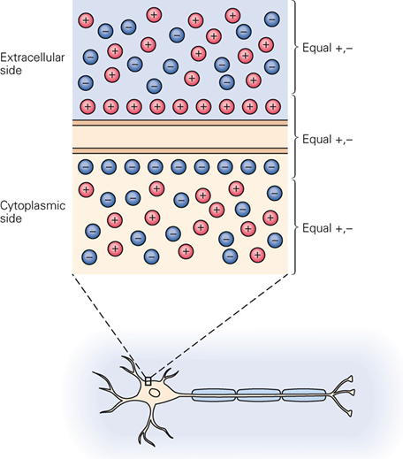
Part 2: Membrane Potential
Resting vs gated ion channels: Resting channels maintain the membrane potential at rest,
Most voltage-gated channels are not open at rest – but require depolarization to open
0 mV
Separation of charge creates potential difference known as the membrane potential:
Vm = Vin - Vout
-70 mV
At rest, it is the resting membrane potential Vr.
When there is a flow of charge or a current, the direction of the current is defined as the direction of net movement of positive charge (by convention).
Notes:
By convention, we set the outside to zero mV. Note that because the direction of current is defined as the direction of net movement of positive charge, if you are talking about the chloride ion moving into the cell, that is an outward current (because chloride is negative).

Slide 32
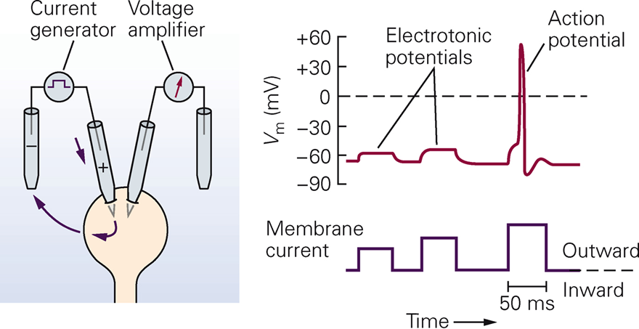
Electrotonic potentials – passive changes in membrane potential that do not lead to opening of gated ion channels
Logethetis diagram
Measured change in membrane potential (pulses create a change in the potential difference)
Current being injected
Notes:
So the action potential is an active change in membrane potential versus passive electrotonic depolarizations.
Hyperpolarizations are purely passive.

Slide 33
When a channel behaves as a simple resistor, what is the name of the equation that governs the resulting current through that channel?
ⓘ Start presenting to display the poll results on this slide.

Slide 34
What is the equation for Ohm's law?
ⓘ Start presenting to display the poll results on this slide.

Slide 35
Distribution of Major Ions at Rest
Squid giant axon
Na⁺ = 440 mM
Na⁺ = 50 mM
K⁺ = 20 mM
K⁺ = 400 mM
Cl⁻ = 560 mM
Cl⁻ = 52 mM
A⁻ = 0 mM
A⁻ = 385 mM
Organic anions
Values are different (mostly lower) for vertebrate neurons

Slide 36
What prevents the ions from simply flowing from inside of the cell to the outside?
ⓘ Start presenting to display the poll results on this slide.

Slide 37
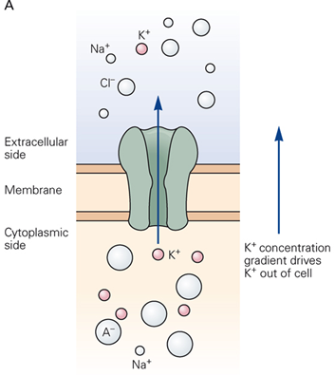
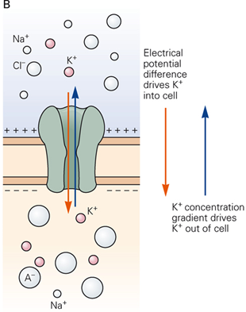
Open channels in glial cells are permeable to potassium only
The permeability of a cell membrane to a particular ion species is determined by the relative proportions of the various types of ion channels that are open.
Na⁺
Na⁺
concentration gradient
K⁺
K⁺
electrical gradient
Cl⁻
Cl⁻
-75 mV
Chemical driving force
Electrical driving force
Notes:
In a glial cell only K+ channels are open at rest. So only the K+ ion can flow.
Because there is more K+ inside than outside, the chemical or concentration gradient is pushing K+ outside (diffusional forces attempt to equalize K+ on either side of membrane).
BUT the as K+ leaves, the inside becomes more negative. Because the inside is negative, it will attract positive ions, thus the K+ electrical gradient is driving K+ inside the cell.
Each ion is subject to these two forces (note that they will be different for each ion).
Eventually the outward movement of K+ (driven by concentration gradient) is equal to inward movement of K+ (driven by electrical gradient). At this point there is no longer any net movement of K+ ions. SO the K+ ions are at equilibrium. The membrane potential at which this occurs is the equilibrium potential for that ion. Since at rest the cell is only permeable to K+ ions, then the resting membrane potential will be the potassium equilibrium potential.

Slide 38
For K+ when the chemical and electrical gradients are balanced, we say the channel is at equilbrium.
This will only be true for a certain potential. That is the EQUILBRIUM Potential **for that ion. Note the potential will be different for each ion species.
There is NO NET CURRENT at Equilibrium Potential.
When a channel opens, there is a driving force towards equilibrium. If the membrane potential is far away from equilibrium, that driving force will be large. If it the membrane potential is close to the equilibrium, that driving force will be small. Driving force for K ions = E_{m} – E_{K}
Where E_{m} = current membrane potential and E_{K} = K+ equilibrium potential
How do we find this equilibrium potential?
The equilibrium potential is based on the concentration of that ion inside and outside of the cell . . .

Slide 39
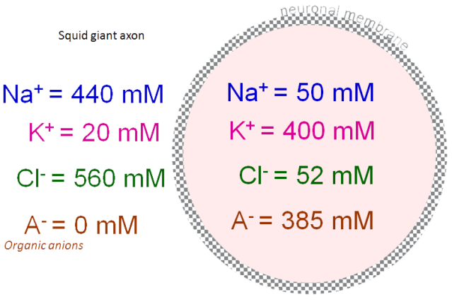
Calculation of the Equilibrium Potential: with the Nernst Equation
R = gas constant
T = the temperature in Kelvin
Z = the valence of the ion
F = the Faraday constant (1 mole of electrons)
[X]_{o} = the concentration of ion X outside the cell
[X]_{i} = the concentration of ion X inside the cell
RT
[X]_{o}
E_{x}
=
ln
zF
[X]_{i}
Since RT/F is 25 mV at 25ºC (77ºF, room temperature), and the constant for converting from natural logarithms to base 10 logarithms is 2.3, (2.3*25 = 58) the Nernst Equation can also be written as:
58
mV
[X]_{o}
E_{x}
=
log
z
[X]_{i}
For K+ in the squid giant axon, z= 1 (positive charge):
58
mV
[20]_{o}
=
-75 mV
E_{K}
=
log
1
[400]_{i}
So -75 mV is the equilibrium potential for K⁺ but also since the glial cell is only permeable to K⁺ at rest, this is ALSO the resting membrane potential.
Notes:
You don’t need to know the following, but if you are interested, in where the gas constant comes from:
The pressure, volume, amount of substance, and temperature of a gas are related according to the following equation, known as the universal gas equation:
PV = NRT
where P represents the pressure in pascals, V represents the volume in meters cubed, N represents the amount of substance in moles, and T represents the absolute temperature in kelvins.
In terms of the pressure, volume, amount of substance, and temperature, the gas constant is equal to:
R = (PV) / (NT)
The gas constant has been found, by experiment, to have a value of approximately 8.3145 joules per kelvin per mole (J · K⁻¹ · mol⁻¹).
Faraday's constant converts quantity of moles to quantity of charge for a univalent ion.

Slide 40
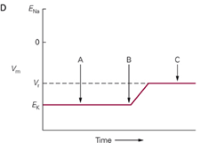
Resting membrane potential in neurons
Unlike glia, neurons are permeable to Na⁺, Cl⁻ AND K⁺ at rest. Only the large organic anions are unable to permeate the cell membrane.
NET driving force
Lengths of arrows represent relative amplitude of driving force
Length of arrows denote the size of net driving force
The resting potential of a cell is determined by the proportions of different types of ion channels that are open, together with the value of their equilibrium potentials.
Add Na⁺ channels
Influx of Na⁺ is balanced by efflux of K⁺. More K⁺ channels than Na⁺ channels. So small net driving force for K⁺ at each channel but because more channels – the K⁺ current balances that of the Na⁺ current with larger driving force but fewer channels
Over time RMP settles at new level
Why is current different than driving force? Because it is affected by the number of channels that are open.
Notes:
In A – cell with only K+ channels present. Resting potential will be based on equilibrium potential of K+ since only those channels are open. There is no net driving force because since the channels are open – it has come to equilibrium.
In B – We have our original K+ channels and now we add Na+ channels in addition to K+ channels – For Na+ - both forces are driving Na+ into the cell, which will make the resting potential a little more depolarized than the K+ equilibrium potential. Overall Sodium current is small – not that many channels in the membrane are open
In C over time, resting potential settles at a new level that is slightly more depolarized than the K+ equilibrium potential due to influx of Na+.
Because the inside is now slightly more depolarized, there is a reduction of the electrical driving force on K+ (as well as on Na+).
The new membrane potential does not come close to the Na+ equilibrium potential of +55 mV because there are many more resting K+ channels than Na+ channels in the membrane.
In B: the Na+ current is smaller than the driving force because there are few channels in the membrane that are open.
In C: The K+ current is larger than the driving force because there are lots of K+ channels in the membrane.

Slide 41
In a resting cell there are few Na⁺ channels open so membrane conductance of Na⁺ is low despite the large chemical and electrical forces driving Na⁺ into the cell.
In contrast, many K⁺ channels are open at rest so the membrane conductance of K⁺ is relatively large even though the force is small.

Slide 42
Contributions of different ions to the resting membrane potential (RMP) can be quantified by the Goldman Equation
In neurons, K⁺, Na⁺ and Cl⁻ channels are open at rest, but the resting membrane potential is not equivalent to the equilibrium potential for any one of these ions, but is at an intermediate value.
When there is more than one ion, the permeability or ease with which the ion crosses the membrane is also a factor. It is typically in units of cm/s or a velocity – similar to a diffusion constant. Permeability is due to the channel conductance AND the number of open channels.
RT
P_{K}[K⁺]_{o} + P_{Na}[Na⁺]_{o} + P_{Cl}[Cl⁻]_{i}
V_{m}
=
ln
F
P_{K}[K⁺]_{i} + P_{Na}[Na⁺]_{i} + P_{Cl}[Cl⁻]_{o}
Valid when Vm is not changing
The greater the concentration of an ion species and the greater its permeability, the greater its contribution to Vm.

Slide 43
Experimentally Determined Permeability Ratios:
Effect of changing these ions on membrane potential was examined (measurement made before internal solution was altered by open channels) – then Goldman equation used to determine permeability:
REST: P_{K} : P_{Na} : P_{Cl} = 1.0 : 0.04 : 0.45
During action potential – values are changing – except at peak of action potential, where ratios are:
AP: 1.0 : 20 : 0.45 - so contribution of K⁺ and Cl⁻ is small enough to be close to negligible.
Once permeability changes – Goldman equation is no longer useful so . . . Need to use a different method to determine currents. So Goldman equation is mainly used to determine RESTING membrane potential.

Slide 44
The greater the concentration of an ion species and the greater its permeability, the greater its contribution to Vm.
RT
P_{K}[K⁺]_{o} + P_{Na}[Na⁺]_{o} + P_{Cl}[Cl⁻]_{i}
V_{m}
=
ln
F
Goldman equation
P_{K}[K⁺]_{i} + P_{Na}[Na⁺]_{i} + P_{Cl}[Cl⁻]_{o}
How might the permeability be reduced?
**remember it is due to the conductance through the channel AND the # of open channels
So if you have very few Na+ and Cl- channels open – what happens?
How can you estimate the membrane potential (Vm) if you do not know the permeability of any of the ions – but you do know that relative to K+, there are very few Na+ and Cl- channels open?
Notes:
The answer to ESTIMATE the RMP is to ignore Na+ and Cl-. SO if the membrane potential is only based on K+ -because those are the open channels – what membrane potential will K+ drive the membrane to? The K+ equilibrium potential. So now you can use the Nernst equation to calculate that and you only need to know the concentrations out and in of K+.

Slide 45
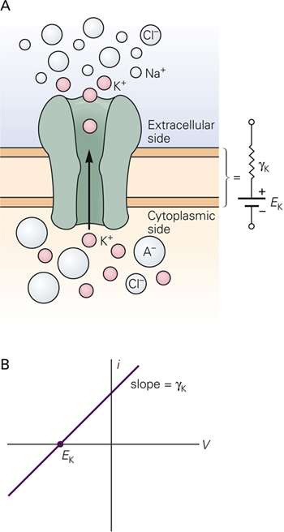
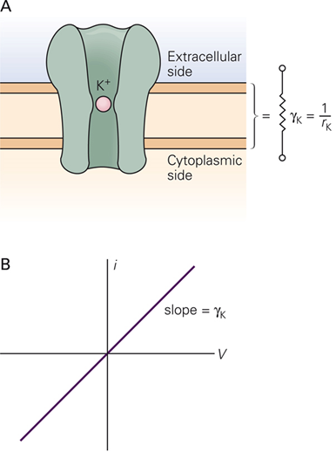
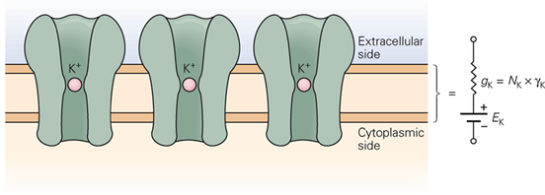
Driving force – (specified per ion or per channel) – the difference between the current membrane potential and the equilibrium potential for that ion/channel.
Potassium driving force: V_{m} – E_{K}
In a real neuron with a membrane potential and a K+ concentration gradient, the net K+ current is the sum of the currents cause by electrical and chemical driving forces:
i_{K} = (γ_{K} * V_{m}) – (γ_{K} * E_{K}) = γ_{K} * (V_{m}- E_{K})
With K⁺ chemical gradient
No chemical gradient
All resting K⁺ channels lumped together

Slide 46
i_{K} = (γ_{K} * V_{m}) – (γ_{K} * E_{K}) = γ_{K} * (V_{m}- E_{K})
So this means even without knowing what the channel conductance is, we can still get a relative measure of the current.
So let’s say the E_{K} = -75 mV.
Which of the following conditions would produce a larger K+ current?
1) A membrane potential of 0 mV
Or
2) A membrane potential of -35 mV?

Slide 47
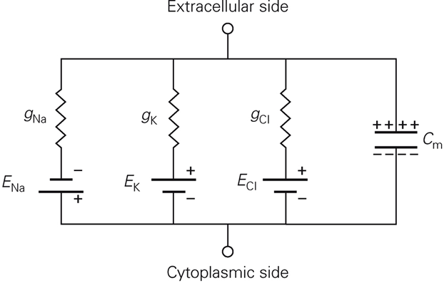
Each group of ion channels lumped together and represented as a resistor and battery.
Extracellular fluid AND cytoplasm are each good conductors (particularly relative to membrane) – because they have a large cross-sectional area and many ions
Remember that the membrane acts as a capacitor because it is an insulator separating two conductors.
Can add Na⁺-K⁺ pump as a current generator.

Slide 48
Equivalent Circuits provide a quantitative description
The phospholipid bilayer is an insulator separating two conductors (ionic solutions inside and outside cell) – this is the definition of capacitance
The electrical potential difference across the capacitor is:
V = Q/C, where Q is the net excess positive charge or negative charge measured in coulombs and C is the capacitance measured in farads.
Rearranging:
C = Q/V
Membrane capacitance is equal to the amount of charge that can be stored on the membrane for a given transmembrane voltage change.
Typical membrane capacitance is 1 uF per cm² of membrane area.
Very few charges are required to produce a large potential difference across such a capacitance.

Slide 49
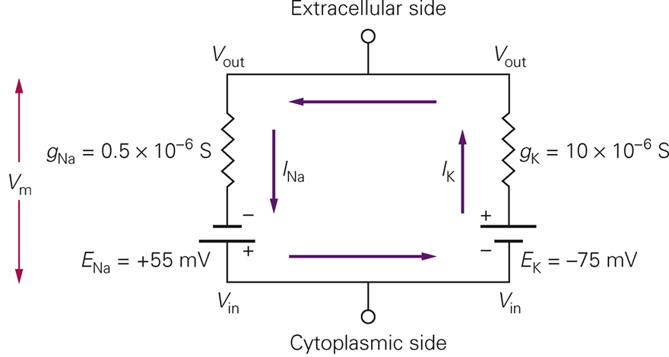
Using the equivalent circuit model to calculate RMP (Kandel Box 6-2)
Chloride initially ignored and small contribution of Na⁺-K⁺ pump ignored.
Vm = -69
Many more K⁺ channels so much higher K⁺ conductance
At rest no net current across membrane, so: I_{NA}= I_{K} or I_{NA} + I_{K} = 0
Total potential difference is the sum of the potential differences across E_{Na} and across g_{Na}. V_{m} = E_{Na} + I_{Na}/g_{Na}
I_{Na} = g_{Na} * (V_{m} – E_{Na}) and I_{K} = g_{K} * (V_{m} – E_{K}) for each branch of circuit
Replace with solved equations:
g_{Na} * (V_{m} – E_{Na}) + g_{K} * (V_{m} – E_{K}) = 0
Rearrange: V_{m} * (g_{Na} + g_{K}) = (E_{Na} * g_{Na}) + (E_{K} * g_{K})
(E_{Na} * g_{Na}) + (E_{K} * g_{K})
Solve for V_{m} =
g_{Na} + g_{K}
Notes:
Because Vm is defined as Vin – Vout, outward current is positive and inward is negative by convention. Batteries whose positive pole is directed toward the inside of the membrane (Ena) are given positive values in the equations.

Slide 50
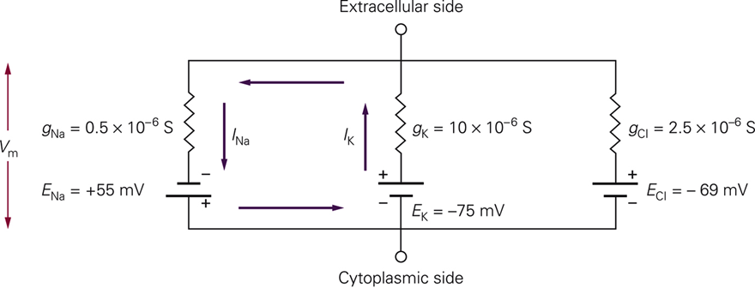
(E_{Na} * g_{Na}) + (E_{K} * g_{K})
V_{m} approaches the value of the ionic battery that has the greater conductance.
V_{m} =
g_{Na} + g_{K}
During an action potential – voltage-gated Na⁺ channels open and Na⁺ conductance is increased 500 fold, while K⁺ is unchanged. Substitute the altered conductance and NOW V_{m} = +50 mV, much closer to E_{Na} than to E_{K}.
real RMP includes g_{Cl}
(E_{Na} * g_{Na}) + (E_{K} * g_{K}) + (E_{Cl} * g_{Cl})
V_{m} =
g_{Na} + g_{K} + g_{Cl}
Because E_{Cl} = V_{m}, there is no current through Cl⁻ channels and thus even including it in calculation will not change V_{m}
Note opens channels at rest are called leakage channels and when considering active channels – can consolidate all leakage current and leakage battery into one.

Slide 51
Ohm’s Law
V = i*R or V = i*1/g
Describes the current-voltage relationship for ohmic (linear or non-rectifying) channels/ions
Used to calculate the equilibrium potential for a particular ion. Note this is also the reversal potential. Also note that in cells with only one type of channel open at rest, the resting membrane potential will be equivalent to the equilibrium potential for that ion.
RT
[X]_{o}
Nernst Equation
E_{x}
=
ln
zF
[X]_{i}
Goldman equation
RT
P_{K}[K⁺]_{o} + P_{Na}[Na⁺]_{o} + P_{Cl}[Cl⁻]_{i}
V_{m}
=
ln
F
P_{K}[K⁺]_{i} + P_{Na}[Na⁺]_{i} + P_{Cl}[Cl⁻]_{o}
Allows you to calculate the resting membrane potential when more than one type of channel is open at rest. Note that permeability (P) reflects the conductance AND the number of open channels per unit membrane.

